Slide 1
Java SE 8 Book Presentation
Chapter 5 – Working With Java Data Types

Slide 2
5.1 Data types in Java – 5.1.1 Data types and Variable types
Data Type = name given for the specific type of value (e.g: Integer = “int” in Java) => classify different types of value allows us to treat each type of data differently and also perform specialized operations on that specific type of value (e.g: we all know what to do with addition operation on ”int” value but not on “Boolean” value). Data type also determines the space required to store that data (e.g: bytes = 8 bits, int = 32 bits). Data type is important since it tells the compiler which type of data we are working on right now (e.g: “int i;” indicates that we are working with integer variable) => the compiler will then allow us to only store integer value on that variable. Defining a variable of a certain types = have a right to perform specific operation on that value
I) Primitive Data Types
) Designed for working with raw data (int, float, char, double, long, short)
) Java automatically understands these data types, knows how much space they take up, what can be done with them
) It is the basic block of Java
) Combining more primitive datatypes using ”class” => more complex data types
II) Reference Data Types
) Design for working with special data types that Java doesn’t know (Java doesn’t know about Student objs, Course objs and Grade objs) => Java doesn’t know which type of operation they support, what is their properties => Java expected us to define all of these. Java has interface, class and enum to handle these definition job, therefore, we are creating reference data type.
) Reference data type is formed by combining many primitive and reference data types
) If something belongs to class, interface, enum => Reference Data Types

Slide 3
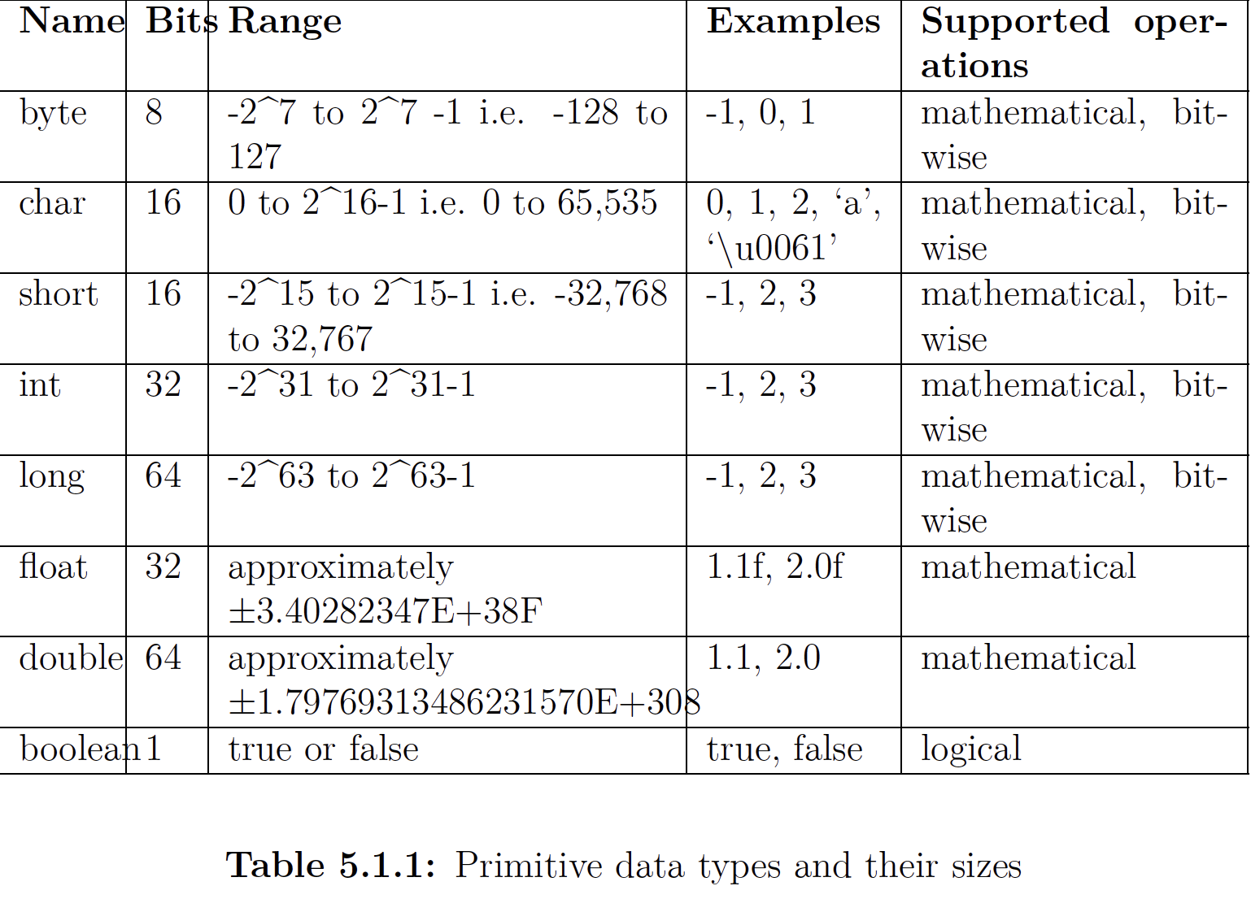
5.1 Data types in Java – 5.1.1 Data types and Variable types

Slide 4
5.1 Data types in Java – 5.1.1 Data types and Variable types
Byte, char, int, long, short: These are called integral data types since they store integral values
char is also an integral type and can store numerical values, however, it cannot store negative numbers since the number it stores will be interpreted into Unicode Character
float / double: Store large but imprecise value
Boolean: Store only 2 values => only requires 1 bit of memory. However, its size is not defined since a chunk of memory is measured differently depending on the type of OS (if the OS version is 32 bits => the Boolean data type takes up to 4 bytes)
A word on “void” keyword and “null” keyword
) ”void” is a keyword in Java and it means “nothing”. It is used as a “return type” of a method to indicate that this method will never return anything => “void” is a type specification and not a data type => a method could be declared as “void” but a variable can’t be declared as “void”.
) “null” is a valid VALUE, not a data type. When a method returns “null”, it is just a special case where the invocation returns an invalid reference but it doesn’t mean that the method always returns nothing. Therefore, we cannot use ”void” as a return statement => return “null” is valid whilst return “void” is invalid. Moreover, a method declared as “void” could omit the return statement or just leave it as “return;”

Slide 5
5.2 Difference between reference variables and primitive variables – 5.2.1 – Reference variable and primitive variable
- ) If we define “int i;”, it means that the variable type is “int”
) If we define “String str;”, it means that the variable type is “java.lang.String”
The difference between primitive variables and reference variables is the stored value inside the variable. While primitive data type store actual values inside, reference variables store the ”memory address” to the real data. For example, ”int i = 10” will store the actual “10” while “String str = hello” will store the RAM address to that ”hello” string. When we are performing operation on reference variable, the actual operation is actually taking place on another location inside RAM
Both values support assignment using “=“ sign
We can only assign the address of the object INDIRECTLY to the reference variable since Java doesn’t allow developers to touch the memory programmatically. For example, “String str = “hello”” will just mean that we are assigning the memory address where “hello” resides. Also, “String str2 = str” will also mean that we just copying the address value to “hello” from ”str” to “str2”
The size of a primitive variable depends on the actual data that the variable is storing
The size of a reference variable depends on the addressing mechanism of the OS
The size of the reference data type such as class depends on the number of instance variables used inside the class since either of them is primitive or referencing variable => their size could be just the sum of all primitive and reference variable.
The size never change for a given class, all instances created will have the same size as each other (no matter what values its instance variable holds) => no need to calculate memory taken space by an instance at runtime

Slide 6
5.3 Declare and initialize variables – 5.3.1 Declaration and Definition
(CODE ILLUSTRATION)

Slide 7
5.3 Declare and initialize variables – 5.3.2 Declare and initialize variable
(CODE ILLUSTRATION)
Naming rule for a variable:
+) Must be a valid Java identifier
+) Always start with a lowercase letter (constant variable always in uppercase)
+) Variable generated by code generation will always start with a “$” or “_”

Slide 8
5.3 Declare and initialize variables – 5.3.3 Uninitialized variables and default value
(CODE ILLUSTRATION)

Slide 9
5.3 Declare and initialize variables – 5.3.3 Uninitialized variables and default value
Java code runs flawlessly if the uninitialized variables aren’t used
Static and instance variables initialize with default values if we don’t initialize them explicitly
Java doesn’t initialize local variables
To make sure that the variable is always initialized with a predetermined value before they are accessed, Java has 2 different approaches
I) JVM automatically initializes the variable
- In this approach, when developers don’t initialize the instance and static variable explicitly, JVM will automatically initialize the variable with default values (these values will be 0 or (0.0) to all numerical variables, “false” for Boolean and ”null” for reference variable) (CODE ILLUSTRATION)

